Slide 1
Object-Oriented Programming-Project 4
Wesley Scott and Brandon Stehling

Slide 2
ATM Class
This is the main frame in our program. It serves to greet the user and allows the user to sign in or create a new account
The instance variables FirstName, LastName, Username, and Password are used to create a new account
The code in this class stores information in a file when a new account is created, and it checks account information from a file when a user signs in

Slide 3
Account Class
This class is the frame for a user’s personal account
The account window welcomes the user with a first and last name, and states the user’s current balance
It allows the user to complete certain tasks including:
Withdraw
Deposit
Change password, which will change the user’s password by asking for the old password and a new password
Sign out, which will take the user back to the ATM home screen

Slide 4
Storage of Data
We use a text file to store the data and information for each account
The data members in each account are declared as private, and we use class methods in order to access and change those data members
Each text file has the format: Username + “.txt”
Password
FirstName
LastName
Balance
Username

Slide 5
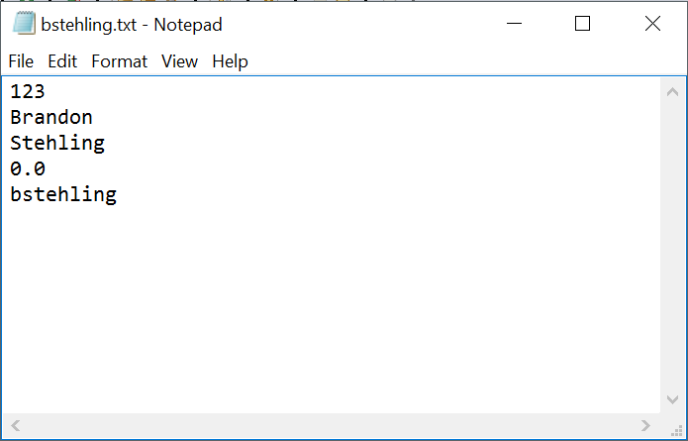
Example of Text File

